Slide 1



CENTRAL BOARD OF EXCISE & CUSTOMS
GST Migration: Workflow
www.cbec.gov.in www.aces.gov.in

Slide 2



GSTN Enrollment Process
1
2
3
Taxpayer obtains
GSTN login id and password from aces.gov.in
Taxpayer completes enrollment process on gst.gov.in
Taxpayer receives provisional GSTIN on appointed date

Slide 3
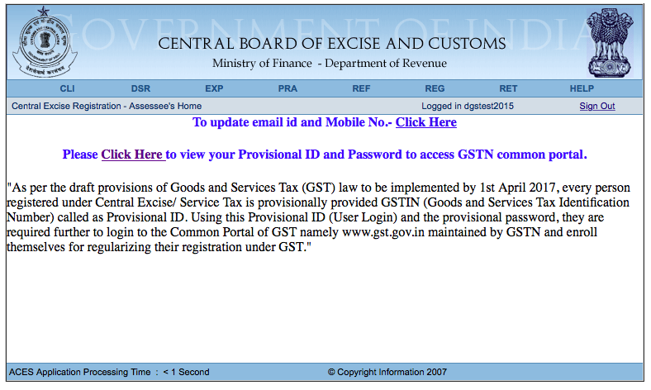
Obtaining credentials
Login to aces.gov.in to view your GSTN Provisional ID and Password

Slide 4
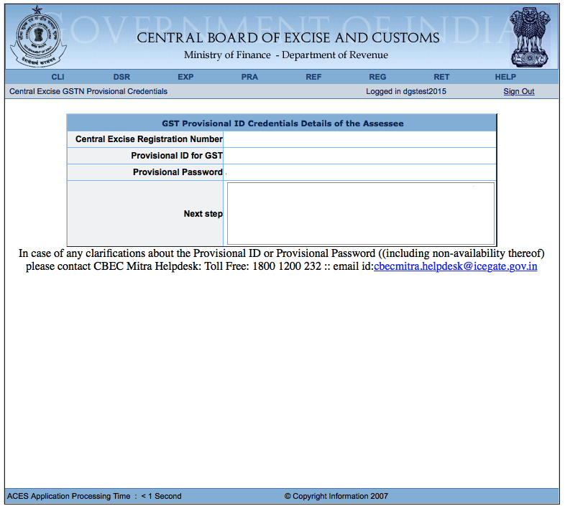
Obtaining credentials
Your ID and Password will appear here

Slide 5
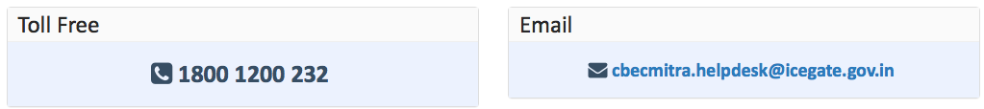
Note on Login Credentials
In some cases, your login credentials may have been shared through State VAT authorities. If you have completed the enrollment process using these credentials, you do not need to repeat the process
In some cases, your ID and Password may still be awaited from GSTN.
For assistance, contact CBEC MITRA

Slide 6
GSTN Enrollment Process
1
2
3
Taxpayer obtains
GSTN login id and password from aces.gov.in
Taxpayer completes enrollment process on gst.gov.in
Taxpayer obtains provisional GSTIN on appointed date

Slide 7
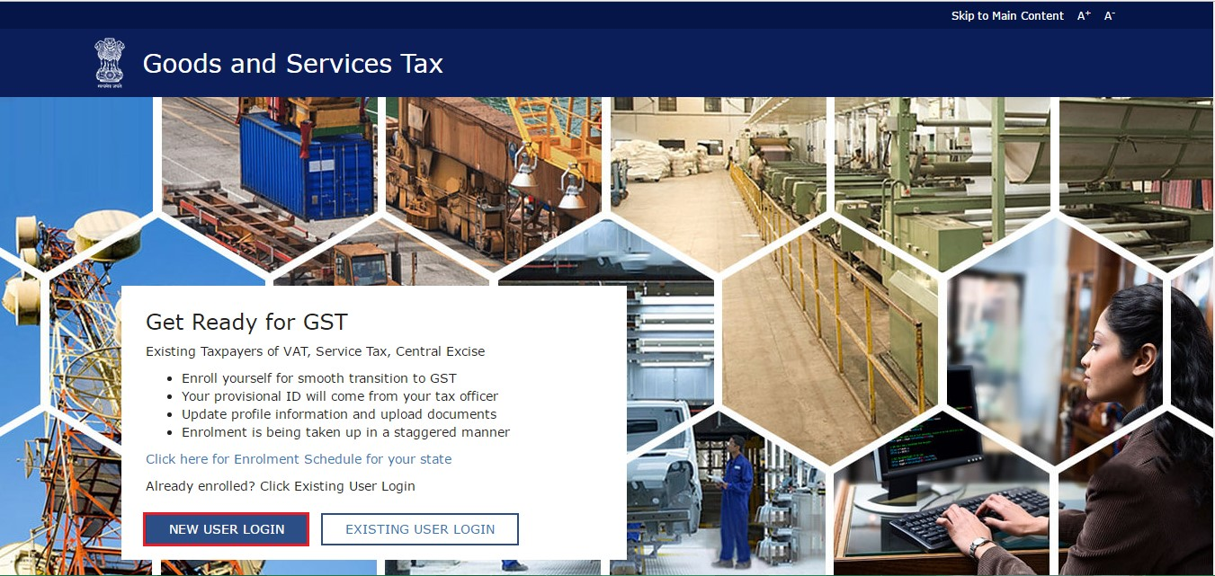
Obtaining credentials
Step 1: Go to gst.gov.in and click on “New User Login”

Slide 8
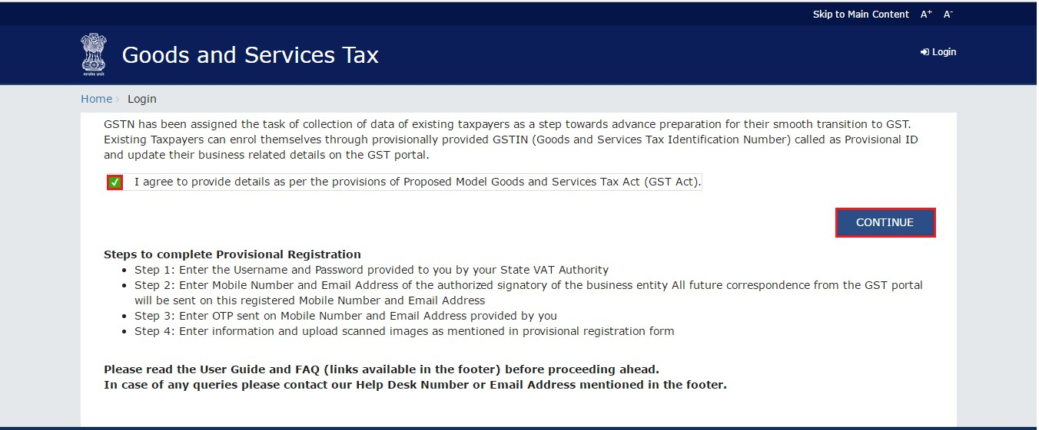
Obtaining credentials
Step 2: Read, select checkbox and hit “Continue”

Slide 9
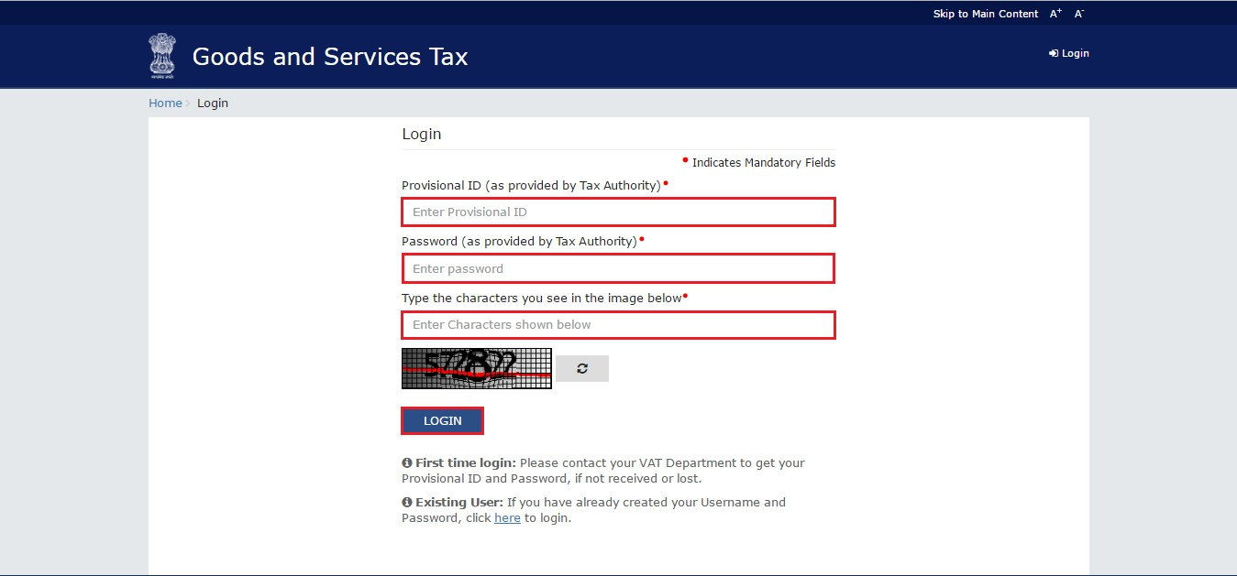
Obtaining credentials
Step 3: Enter Provisional ID and Password received in ACES website

Slide 10
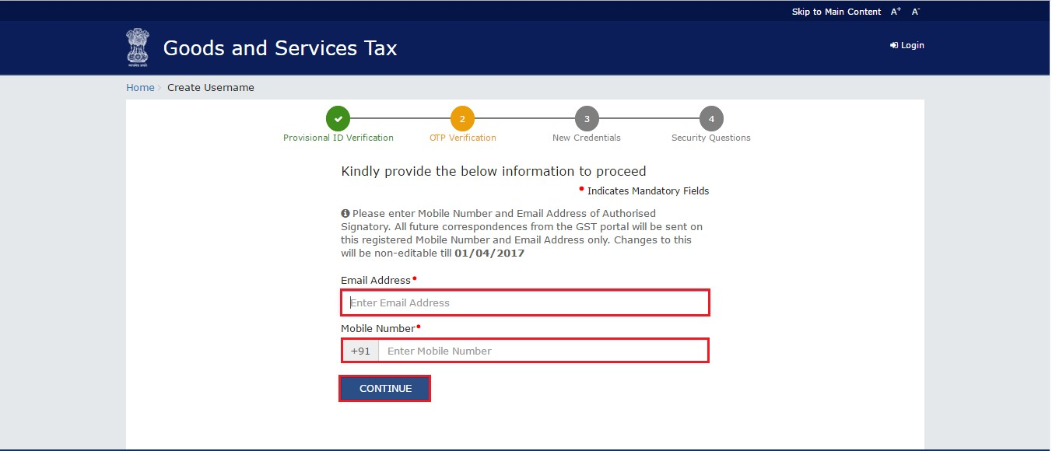
Obtaining credentials
Step 4: Enter valid email address and mobile number

Slide 11
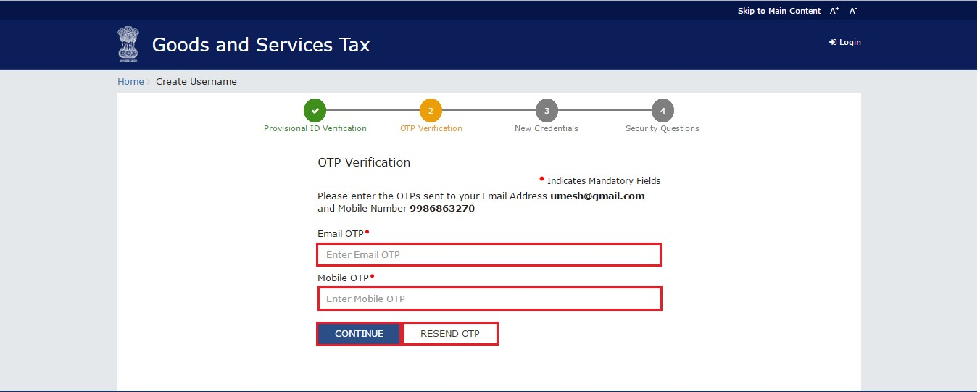
Obtaining credentials
Step 5: Verify email and mobile number using OTP

Slide 12
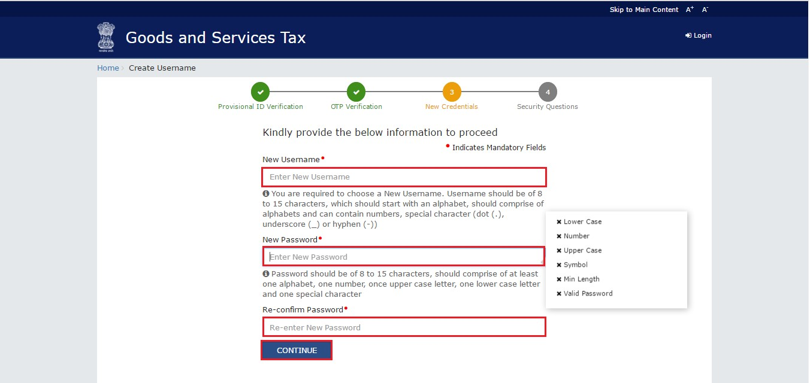
Obtaining credentials
Step 6: Select Username and Password for subsequent Login

Slide 13
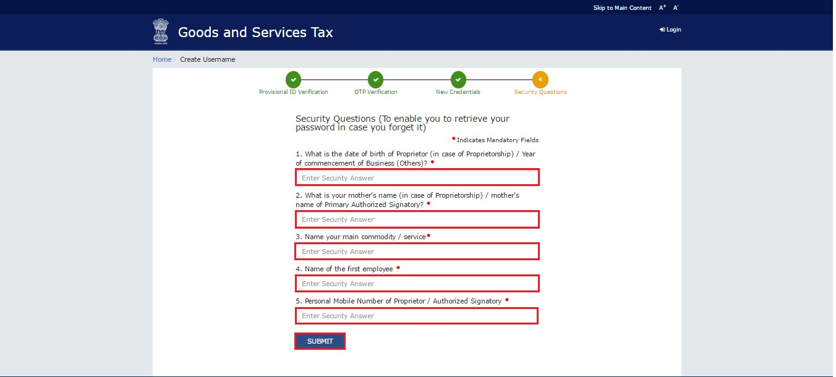
Obtaining credentials
Step 7: Answer security questions to help with password reset

Slide 14
Obtaining credentials
Step 8: Answer security questions to help with password reset

Slide 15
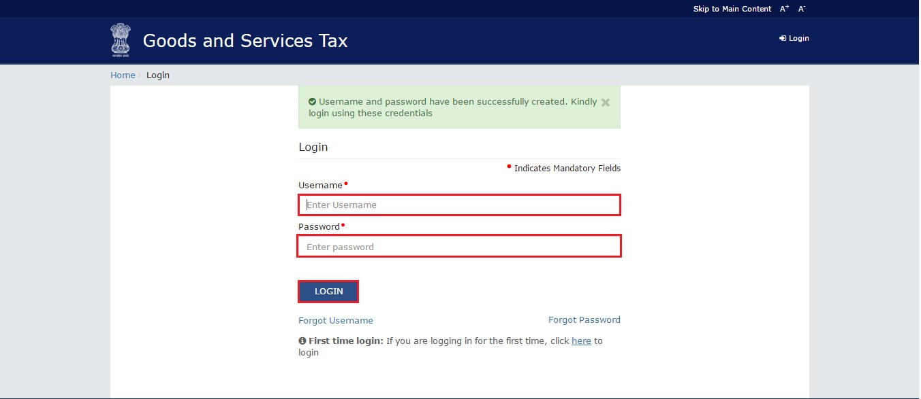
Obtaining credentials
Step 9: Login using your newly created ID and Password

Slide 16
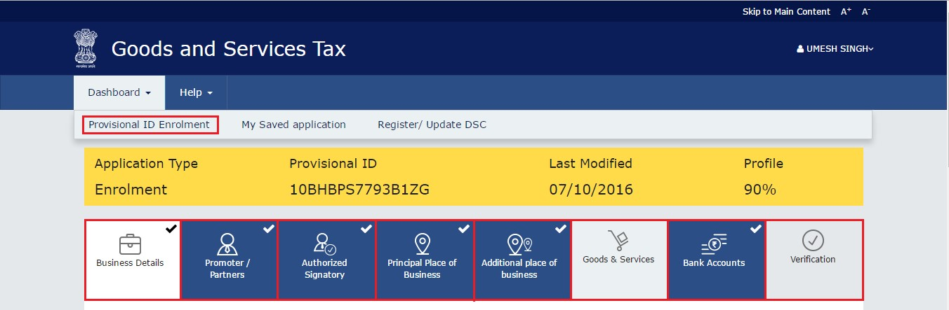
Obtaining credentials
Step 10: Complete the enrollment form, upload documents

Slide 17
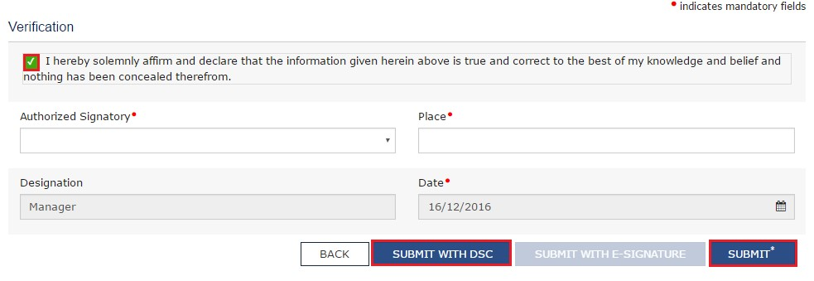
Obtaining credentials
Step 11: Verify the form and submit
Note: In case of Companies and LLPs, form has to be digitally signed.
In other cases, form may be submitted through e-signature (OTP)

Slide 18
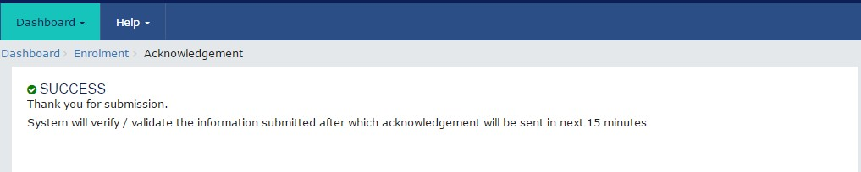
Obtaining credentials
Upon successful submission, Application Reference Number (ARN)
is received through email and SMS

Slide 19
Data and Documents Required for Enrolment
BUSINESS DETAIL | Registration certificate Partnership deed (if applicable) | PDF/JPEG(1MB)
PROMOTERS/PARTNERS | Photograph (for each) | JPEG(100KB)
AUTHORISED SIGNATORY | 1.Proof of appointment 2.Photo | PDF/JPEG(1MB) JPEG(100KB)
PRINCIPAL / ADDITIONAL PLACES OF BUSINESS | Address proof (for each) | PDF/JPEG(1MB)
BANK ACCOUNTS | Statement/First page (for each) | PDF/JPEG(1MB)

Slide 20
GSTN Portal Help
For any assistance with GSTN Common Portal, contact GSTN helpdesk:
0124-4688999
helpdesk@gst.gov.in
http://tutorial.gst.gov.in

Slide 21
GSTN Enrollment Process
1
2
3
Taxpayer obtains
GSTN login id and password from aces.gov.in
Taxpayer completes enrollment process on gst.gov.in
Taxpayer obtains provisional GSTIN on appointed date

Slide 22
Relevant provision of Model GST Law
Sec 166. Migration of existing taxpayers to GST
(1) On the appointed day, every person registered under any of the earlier laws and having a valid PAN shall be issued a certificate of registration on a provisional basis in such form and manner as may be prescribed.
(2) The certificate of registration issued under sub-section (1) shall be valid for a period of six months from the date of its issue: PROVIDED that the said validity period may be extended for such further period as the
Central/State Government may, on the recommendation of the Council, notify.
(3) Every person to whom a certificate of registration has been issued under subsection (1) shall, within the period specified under sub-section (2), furnish such information as may be prescribed.
(4) On furnishing of such information, the certificate of registration issued under subsection (1) shall, subject to the provisions of section 23, be granted on a final basis by the Central/State Government.
(5) The certificate of registration issued to a person under sub-section (1) may be cancelled if such person fails to furnish, within the time specified under subsection (2), the information prescribed under sub-section (3).
(6) The certificate of registration issued to a person under sub-section (1) shall be deemed to have not been issued if the said registration is cancelled in pursuance of an application filed by such person that he was not liable to registration under section 23.
(7) A person to whom a certificate of registration has been issued on a provisional basis and who is eligible to pay tax under section 9, may opt to do so within such time and in such manner as may be prescribed: PROVIDED that where the said person does not opt to pay tax under section 9 within the time prescribed in this behalf, he shall be liable to pay tax under section 8.

Slide 23
Relevant provision of Draft Registration Rules
Rule 14. Migration of persons registered under Earlier Law
(1) Every person registered under an earlier law and having a Permanent Account Number issued under the Income Tax Act, 1961 (Act 43 of 1961) shall be granted registration on a provisional basis and a certificate of registration in FORM GST REG- 21, incorporating the Goods and Services Tax Identification Number (GSTIN) therein, shall be made available on the Common Portal.
(2)(a) Every person who has been granted a provisional registration under subrule (1) shall submit an application electronically in FORM GST REG–20, duly signed, along with the information and documents specified in the said application, on the Common Portal either directly or through a Facilitation Centre, notified by the Board or Commissioner.
(b) The information asked for in clause (a) shall be furnished within the period specified in section 142 or within such further period as may be extended by the Board or Commissioner in this behalf.
(c) If the information and the particulars furnished in the application are found, by the proper officer, to be correct and complete, a certificate of registration in FORM GST REG-06 shall be made available to the registered taxable person electronically on the Common Portal.
(3) Where the particulars and/or information specified in sub-rule (2) have either not been furnished or not found to be correct or complete, the proper officer shall cancel the provisional registration granted under sub-rule (1) and issue an order in FORM GST REG- 22:
Provided that no provisional registration shall be cancelled as aforesaid without serving a notice to show cause in FORM GST REG-23 and without affording the person concerned a reasonable opportunity of being heard.
(4) Every person registered under any of the earlier laws, who is not liable to be registered under the Act may, at his option, file electronically an application in FORM GST REG-24 at the Common Portal for cancellation of the registration granted provisionally to him and the proper officer shall, after conducting such enquiry as deemed fit, cancel the said provisional registration.

